Slide 1
Train Safety Awareness Week /
International Level Crossing Awareness Day
Social Recap
5/31/15 – 6/5/15

Slide 2
Analysis Totals
Total Posts: 13
Reach: 49,761

Slide 3
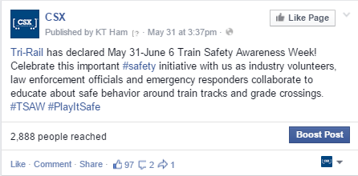
POST 1: May 31, 2015
Facebook
“Tri-Rail has declared May 31-June 6 Train Safety Awareness Week! Celebrate this important ‪#‎safety initiative with us as industry volunteers, law enforcement officials and emergency responders collaborate to educate about safe behavior around train tracks and grade crossings.‪ #‎TSAW ‪#‎PlayItSafe”
Reach: 2,886 Post Clicks: 56 Likes, Comments & Shares: 104

Slide 4
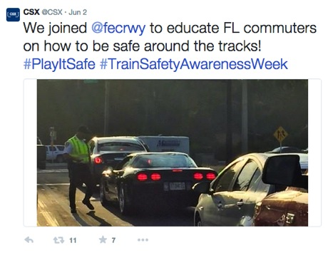
POST 2: June 2, 2015
Twitter
“Our coordinators are receiving chemistry training at the Atlanta REDI center. #TrainSafetyAwarenessWeek #PlayItSafe
Impressions: 3,504 Embedded Media Views: 47 Retweets: 11
Favorites: 7

Slide 5
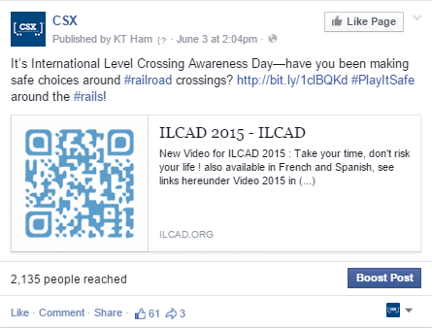
POST 3: June 3, 2015
Facebook
“It’s International Level Crossing Awareness Day—have you been making safe choices around ‪#‎railroad crossings? http://bit.ly/1clBQKd ‪#‎PlayItSafe around the ‪#‎rails!”
Reach: 2,126 Post Clicks: 27 Likes, Comments & Shares: 78

Slide 6
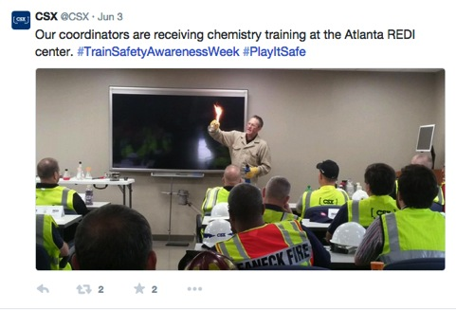
POST 4: June 3, 2015
Twitter
“Our coordinators are receiving chemistry training at the Atlanta REDI center. #TrainSafetyAwarenessWeek #PlayItSafe
Impressions: 2,884 Embedded Media Views: 53 Retweets: 2
Favorites: 2

Slide 7
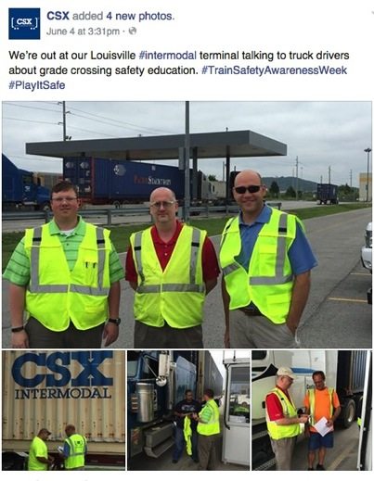
POST 5: June 4, 2015
Facebook
“We’re out at our Louisville ‪#‎intermodal terminal talking to truck drivers about grade crossing safety education. ‪#‎TrainSafetyAwarenessWeek‪ #‎PlayItSafe”
Reach: 3,822 Post Clicks: 285 Likes, Comments & Shares: 183

Slide 8
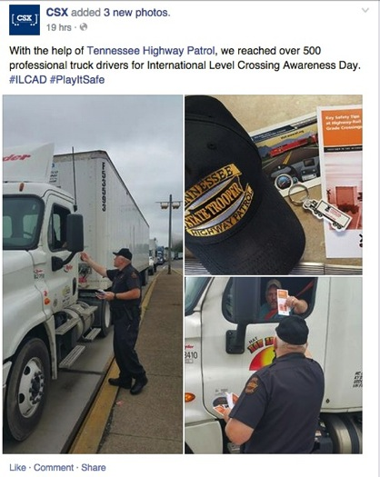
POST 6: June 3, 2015
Facebook
“With the help of Tennessee Highway Patrol, we reached over 500 professional truck drivers for International Level Crossing Awareness Day. #‎ILCAD ‪#‎PlayItSafe”
Reach: 7,340 Post Clicks: 569 Likes, Comments & Shares: 138

Slide 9
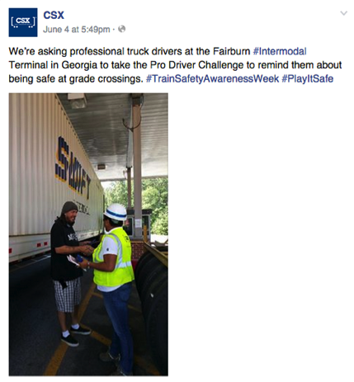
POST 7: June 4, 2015
Facebook
“We’re asking professional truck drivers at the Fairburn ‪#Intermodal Terminal in Georgia to take the Pro Driver Challenge to remind them about being safe at grade crossings. ‪#TrainSafetyAwarenessWeek‪ #‎PlayItSafe”
Reach: 6,072
Post clicks: 231
Likes, Comments & Shares: 237

Slide 10
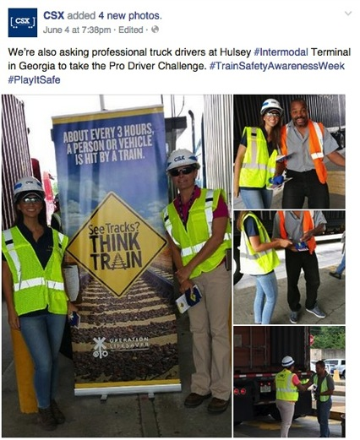
POST 8: June 4, 2015
Facebook
“We’re also asking professional truck drivers at Hulsey ‪#‎Intermodal Terminal in Georgia to take the Pro Driver Challenge. ‪#‎TrainSafetyAwarenessWeek #‎PlayItSafe”
Reach: 6,256 Post Clicks: 722
Likes, Comments & Shares: 255

Slide 11
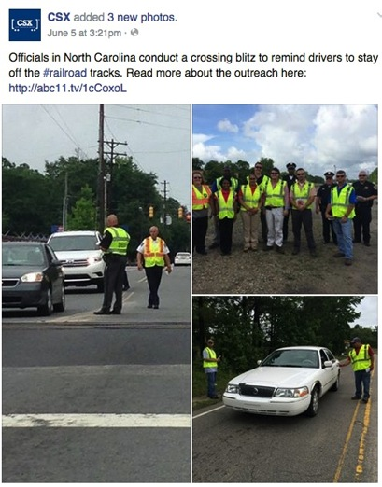
POST 9: June 5, 2015
Facebook
“Officials in North Carolina conduct a crossing blitz to remind drivers to stay off the ‪#‎railroad tracks. Read more about the outreach here: http://abc11.tv/1cCoxoL”
Reach: 3,880 Post Clicks: 350 Likes, Comments & Shares: 150

Slide 12
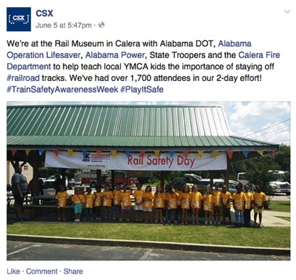
POST 10: June 5, 2015
Facebook
“We’re at the Rail Museum in Calera with Alabama DOT, Alabama Operation Lifesaver, Alabama Power, State Troopers and the Calera Fire Department to help teach local YMCA kids the importance of staying off ‪#‎railroad tracks. We've had over 1,700 attendees in our 2-day” effort!‪ #‎TrainSafetyAwarenessWeek ‪#‎PlayItSafe”
Reach: 3,640 Post Clicks: 79
Likes, Comments & Shares: 185

Slide 13
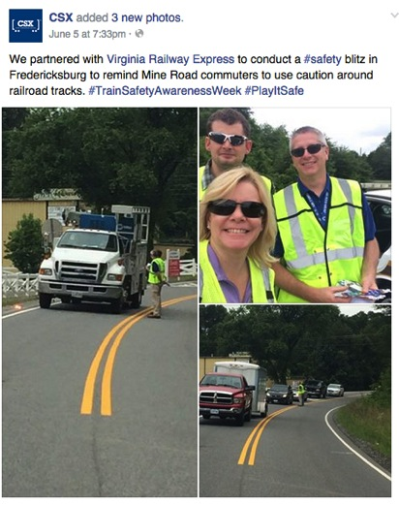
POST 11: June 5, 2015
Facebook
“We partnered with Virginia Railway Express to conduct a ‪#‎safety blitz in Fredericksburg to remind Mine Road commuters to use caution around railroad tracks. ‪#‎TrainSafetyAwarenessWeek ‪#‎PlayItSafe”
Reach: 3,150 Post Clicks: 240
Likes, Comments & Shares: 164

Slide 14
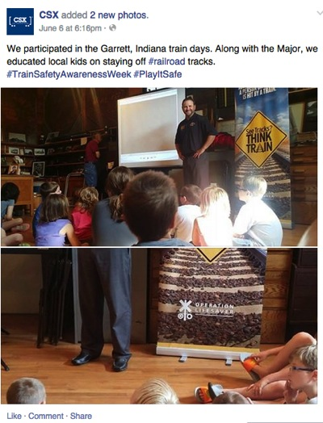
POST 12: June 6, 2015
Facebook
“We participated in the Garrett, Indiana train days. Along with the Major, we educated local kids on staying off ‪#‎railroad tracks. ‪#‎TrainSafetyAwarenessWeek ‪#‎PlayItSafe”
Reach: 2,009
Post Clicks: 135 Likes, Comments & Shares: 101

Slide 15
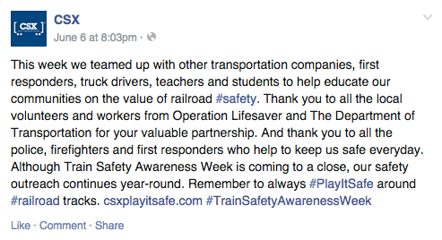
POST 13: June 6, 2015
Facebook
“This week we teamed up with other transportation companies, first responders, truck drivers, teachers and students to help educate our communities on the value of railroad ‪#‎safety. Thank you to all the local volunteers and workers from Operation Lifesaver and The Department of Transportation for your valuable partnership. And thank you to all the police, firefighters and first responders who help to keep us safe everyday. Although Train Safety Awareness Week is coming to a close, our safety outreach continues year-round. Remember to always ‪#‎PlayItSafe around ‪#‎railroad tracks. csxplayitsafe.com #‎TrainSafetyAwarenessWeek”
Reach: 2,192 Post Clicks: 43
Likes, Comments & Shares: 91

